Slide 1





Present Simple
Tense
1

Slide 2
Language at Work: Present Simple
Facts • Habits • Routines • General Truths

Slide 3


What is the Present Simple?
Key Points
Used for facts and general truths
Describes routines and habits
Talks about permanent situations
Common in everyday and business English
Examples
Water boils at 100°C.
She works in marketing.
They travel every month.

Slide 4


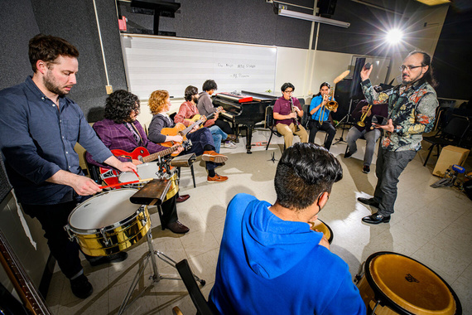
Positive Forms
Rule
Subject + Base Verb
Important
Add -s or -es with:
he
she
it
Examples
He specializes in high-tech products.
She works in finance.
They specialize in Latin American music.

Slide 5

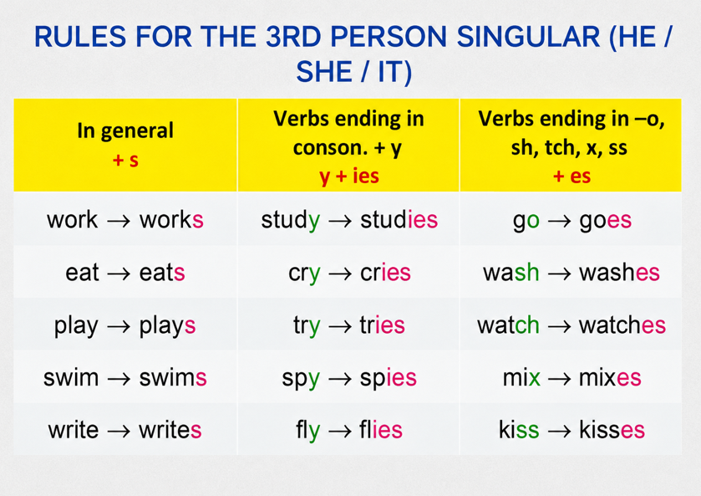
Spelling Rules
These spelling changes help pronunciation and are very common in English writing.

Slide 6
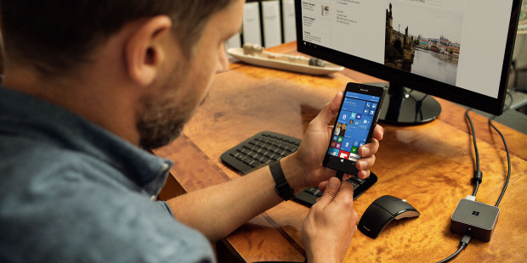

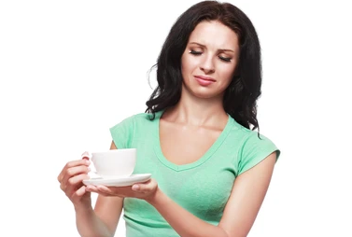
Negative Form
Rule
Subject + do/does + not + base verb
Examples
It doesn’t produce software.
We don't speak Spanish.
She doesn’t like coffee.
Reminder
After doesn’t, use the base verb:
Incorrect: doesn’t works
Correct: doesn’t work
Important
After doesn’t, use the base verb:
Incorrect: doesn’t works
Correct: doesn’t work

Slide 7

Present Simple: Questions
Yes/No Questions
Do/Does + subject + base verb?
Examples
Do you have many competitors?
Does she work here?
WH- Questions
Question Word + do/does + subject + verb
Examples
Where do you work?
What does he do?

Slide 8

Present Simple:
Common Mistakes
Mistake 1
Incorrect: He don’t work here.
Correct: He doesn’t work here.
Mistake 2
Incorrect: Do she like tea?
Correct: Does she like tea?
Mistake 3
Incorrect: She work every day.
Correct: She works every day.

Slide 9


Practice
Practice
Complete the Sentences
She _____ (work) in HR.
They _____ (not/live) in Brazil.
_____ he speak Spanish?
Where _____ you work?

Slide 10
Practice
Practice
Complete the Sentences
She works in HR.
They don’t live in Brazil.
Does he speak Spanish?
Where do you work?

Slide 11
Summary
Present Simple
Used for facts, habits, routines, and permanent situations.
Add -s/-es to verbs with he, she, it.
Use do/does for questions and negatives.
After do/does, use the base form of the verb.
The verb be is irregular:
I am
You/We/They are
He/She/It is

